Slide 1
Dependency Management for C++ Applications using CMake + Conan
Kunal Sharma
Software Engineer at Infineon Technologies

Slide 2
What can you expect?
Write a CMake file
Install/Consume CMake packages
Write a Conan file
Create/Fetch Conan packages
Utilize open source efficiently

Slide 3
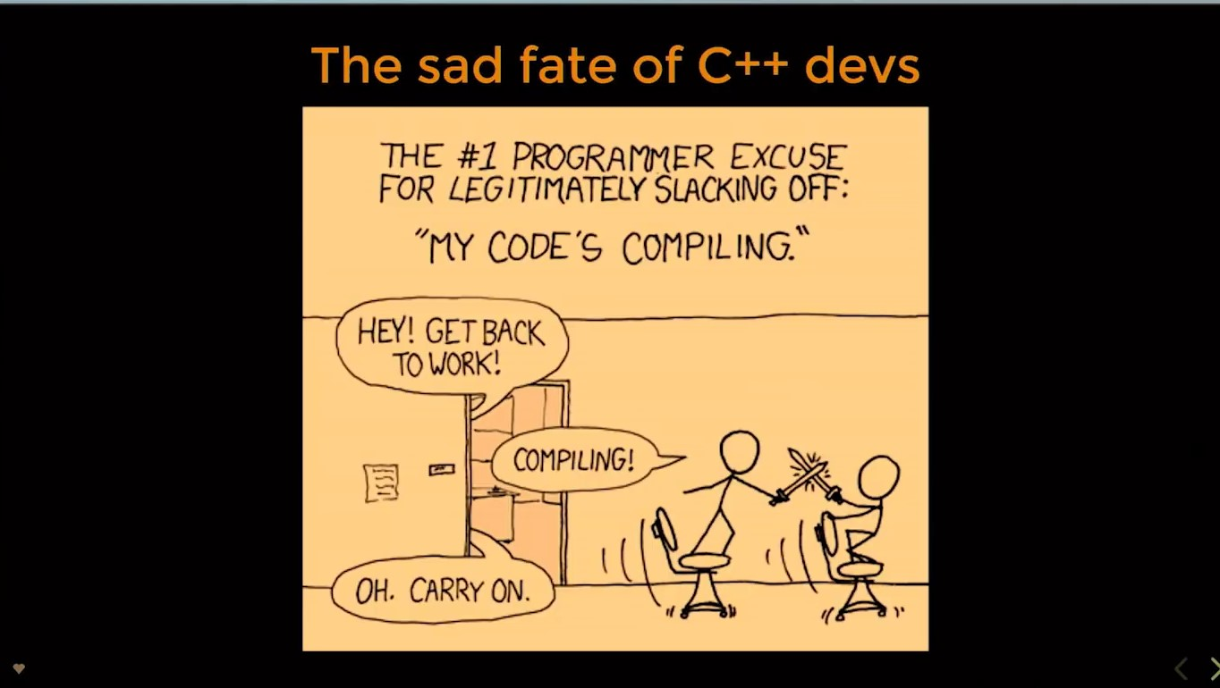

Everyday Struggle
Can we reduce the redundant builds?

Slide 4









Need for Dependency Management
Dependency Management
Present
Future
Lib A
Lib A

Slide 5

Quick Questions
What is Dependency Management?
Dependency management is a technique for declaring, resolving and using dependencies required by the project in an automated fashion.
What is a Package Manager?
A package manager or package-management system is a collection of software tools that automates the process of installing, upgrading, configuring, and removing computer programs for a computer's operating system in a consistent manner.
What is a Build System?
A build system allows you to transform your project assets into a final usable product that can be consumed by a consumer.

Slide 6




Build Systems for C++
Make
Autotools
SCons
Premake
CMake

Slide 7
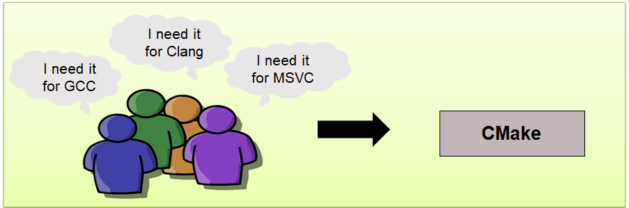
CMake – What & Why
Platform independent build system generator
Native build intent adds to better performance (e.g. *.sln, Makefile, etc.)
Wide pool of generators available
How to generate this build intent?
CMakeLists.txt
cmake path_to_CMakeLists.txt –G “Visual Studio 16 2019”

Slide 8
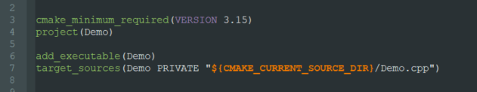
CMakeLists.txt
Modern CMake suggests writing target specific CMakeLists.txt files.
Targets – They are the high level logical placeholders useful in generating the various usable products from the build process.
Scopes in CMake:
PUBLIC
PRIVATE
INTERFACE
CMakeLists.txt
TARGET

Slide 9
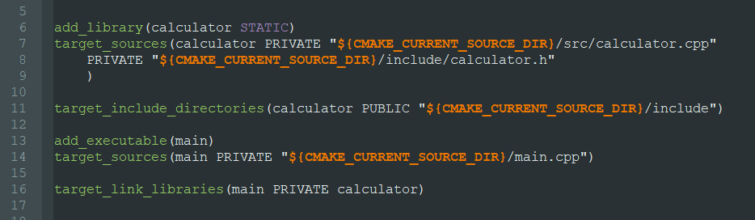
Easy Integration of Libraries
Normal libraries
STATIC
SHARED
INTERFACE (header only libraries)
Following target specific approach allows you to bind properties to a target and avoid conflicts at the global level. Reusing this target at some place means reusing all its properties.

Slide 10

Scopes in CMake
PUBLIC PRIVATE INTERFACE
Target A
Target A
Target A
Target B
Target B
Target B
Target C
Target C
Target C

Slide 11
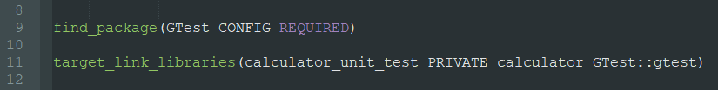

Consuming CMake Packages
find_package() – Finds an external package and loads its settings
Two ways of using find_package():
MODULE
CONFIG
find_package() looks for the external package with the help of a variable called CMAKE_PREFIX_PATH .
Package Name
External Target
Exception - FindBoost

Slide 12
Install/Export in CMake
Install/Export feature of CMake allows you to distribute and consume packages.
The export command exports your target from the build tree for external use.
Install command lets you install files in your CMake package
To create/consume a package with CMake, you need:
Config file
Targets file
Version file
The main ingredient behind generation of these files:
CMakePackageConfigHelpers
Contains helper functions – configure_package_config_file(), write_basic_package_version_file()

Slide 13
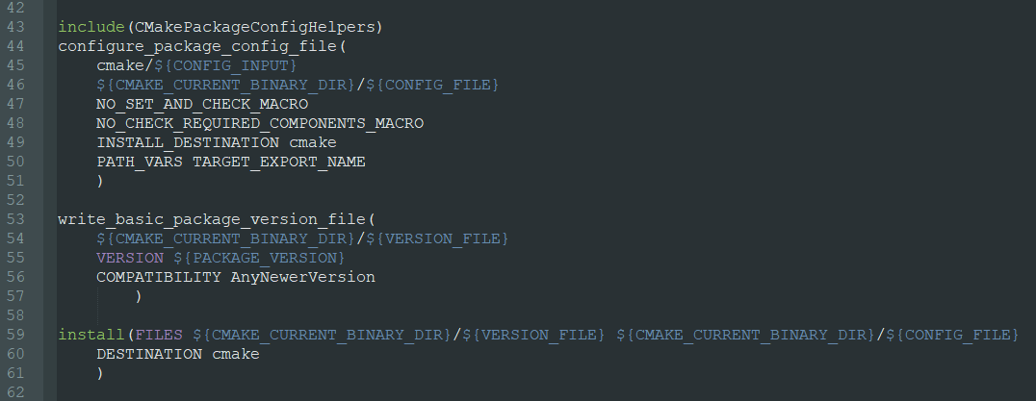
Install/Export in CMake

Slide 14
Handling Transitive Dependency in CMake
CMakeFindDependencyMacro helps out in handling transitive dependencies beautifully.
find_dependency() helper function wraps a find_package() call for a package dependency.
Lib A
hints
Lib B
Transitive Dependency
Lib C

Slide 15
Some final notable points
Capable to execute unit tests through CTest
Easily gels with IDE’s
Extensive community support
Widely accepted within the community
GTest, Qt, SystemC, etc.

Slide 16

References
CMake: https://cmake.org/
CMake tutorial: https://medium.com/@kkunalsharma825/how-to-begin-with-cmake-78c2dced0797
Git, CMake, Conan at CppCon: https://www.youtube.com/watch?v=S4QSKLXdTtA
Connect with me: https://in.linkedin.com/in/kunalsharmaaa
THANK YOU

